Slide 1

F&B (Food &Beverage) SERVICES ANALYSIS DASHBOARD OF UNITED AIRLINES
Akash Singh
2K20/ME/24
Delhi Technological University

Slide 2



Agenda
Introduction
Task
Insights & Recommendation
Suggestion

Slide 3
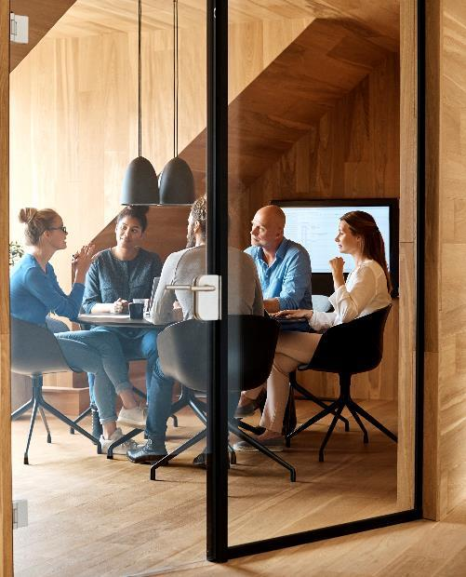



Introduction
As United Airlines is on its journey to becoming the largest airline in the world, our focus continues to be on what our customers think of our products and service and ensuring they are taken care of in the friendly skies. As an analyst, you are required to leverage data to help in identifying opportunity areas in United’s current Food &Beverage(F&B) service and make recommendations which can help in increasing F&B (Food &Beverage) service satisfaction rate by identifying pain points for our customers and challenges in our current inventory planning.

Slide 4

BACKGROUND Various studies suggest that airline F&B service has a significant impact on customer experience and loyalty generation. F&B is also one of the key concerns of unhappy customers as captured in their feedback forms. We have spent the last few years focusing on improving F&B service by partnering with global & regional vendors, encouraging customers to prebook their meals wherever applicable and improving forecasts for inventory. However, with constant network expansion plans and evolving demand, this continues to be an area of focus. Customers who pre-order their meals have a better satisfaction rate compared to those who do not. However, a small fraction of travelers prebook meals at this point. Meal options can vary by market and haul type (Haul type is defined based on how long the flight is based on duration/miles). Some short haul markets (specially <500 miles) would not offer any meal-service which can be of concern specially for customers with multiple connections. United uses a hub-and-spoke model to connect passengers between different cities. In a hub-and-spoke model, there is a central airport, called the hub, that serves as a connecting point for flights to and from other airports, called spokes. This helps in consolidating traffic from multiple spokes into the hub, and then flying larger aircraft on the hub-to-hub routes and can lead to lower operating costs for airlines. However, from the perspective of Inflight service, hub-spoke model can result in better customer experience on hub flights compared to spoke flights.

Slide 5
How is F&B Satisfaction Calculated? United measures F&B satisfaction using our NPS (Net Promoter Score) survey. Customers are asked - How satisfied were you with the food & beverage served on your flight from [CITY] to [CITY]? Customers can score between 0-5 and can also provide additional feedback under - Is there anything else you would like to share about the food & beverage served on your flight from [CITY] to [CITY]? % Inflight Satisfaction = Satisfied Sample/Total Sample*100 Satisfied Sample = Score is either 4 or 5 (Score ranges from 0-5)

Slide 6

Task
Perform root cause analysis to identify key drivers of F&B satisfaction score during summer months & Use survey comments to understand major themes related to F&B that customers are complaining about.

Slide 7
Data description
Survey data – Inflight Satisfaction Score
Survey data – Customer comments/feedback
Inflight Service – Pre order data
Inflight Service – Inventory data (only for Business/First Class)

Slide 8
MAIN GOALS
Increase F&B Service Satisfaction Rate
In other words, the primary objective is to enhance customer satisfaction with United Airlines' Food & Beverage service. Achieving this goal involves various sub-goals and tasks, including:
Identifying Opportunities: Analyze data to identify areas where the F&B service can be improved and where customer satisfaction can be enhanced.
Root Cause Analysis: Determine the key drivers of F&B satisfaction scores, especially during the summer months when travel is typically high.
Customer Feedback Analysis: Analyze customer comments and feedback to understand the major themes and specific issues related to the F&B service that customers are complaining about.
Recommendations: Make data-driven recommendations for improving the F&B service based on the analysis findings.
Presentation: Create a presentation summarizing key findings and recommendations for stakeholders.
Continuous Improvement: Consider further deep dives or analyses to gain a better understanding of underlying issues and continue working towards higher customer satisfaction in the F&B service.
Ultimately, the overarching goal is to enhance the overall customer experience and loyalty by addressing pain points, improving service quality, and making informed decisions based on data analysis.

Slide 9
Steps used in analysis
Step 1: Data Collection and Import
1.1. Data Sources: Identify and gather your data sources. This can include databases, Excel files, web services, or cloud-based data storage.
1.2. Data Import: Open Power BI Desktop and select "Get Data" to import your data. Choose the appropriate data source and connect to it. You may need to provide connection details or credentials.
1.3. Data Transformation*: Use Power Query Editor to clean and transform your data. This can involve removing duplicates, handling missing values, renaming columns, and applying data type conversions.
Step 2: Data Modeling
Step 3: Data Visualization
3.1. Report View: Switch to the "Report" view in Power BI.
3.2. Choose Visualizations: Drag and drop fields from your data model onto the canvas to create visualizations. You can choose from various chart types like bar charts, line charts, pie charts, etc.
3.3. Customize Visuals: Customize visuals by changing colors, labels, and formatting to make them more informative and appealing.
3.4. Interactivity: Add interactivity to your report using slicers, filters, and drill-through options. This allows users to explore data dynamically.
Step 4: Creating Dashboards
Step 5: Data Sharing and Publishing

Slide 10
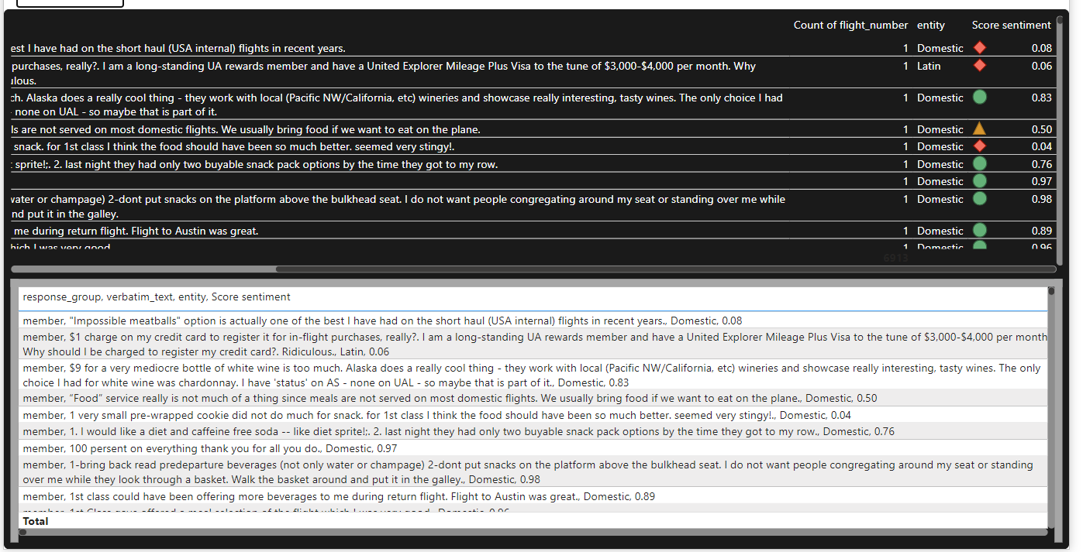
Sentiment Analysis for analysis Comments
Use Sentiment analysis approach for analysis comments on basis of scores from 0-1.
0-0.37 score that means negative
0.38-0.66 score that means neutral
0.67-1 score that means Positive.

Slide 11
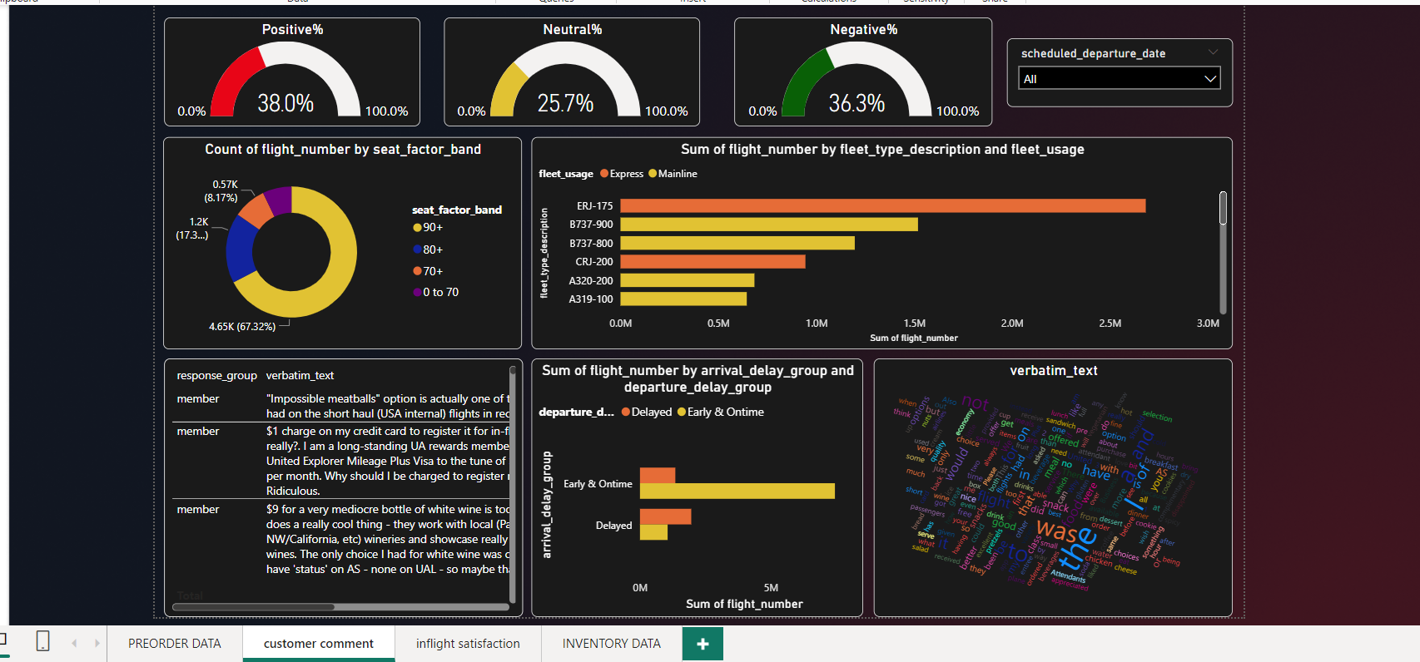
Sentiment Analysis for analysis Comments
By using sentiment analysis, we can find out the percentages of comments i.e.
Positive % - 38%
Negative % - 36.3%
Neutral % - 25.7%

Slide 12
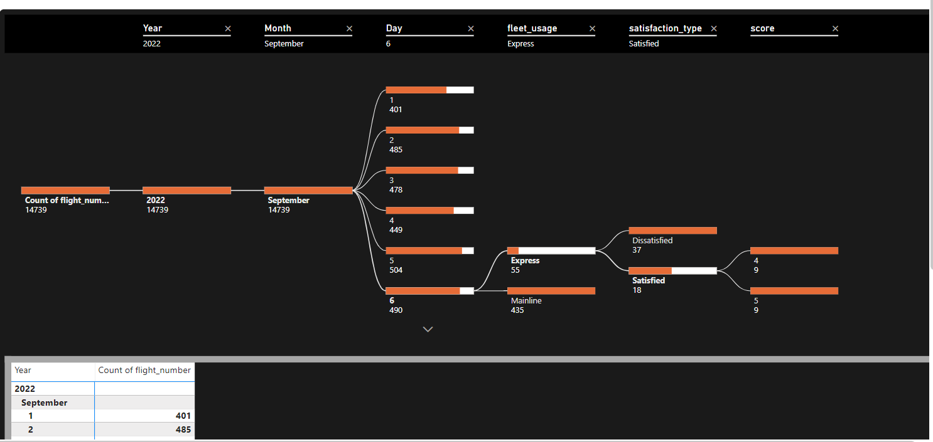
Decomposition Tree
A Decomposition Tree in Power BI is a powerful visual tool that helps users explore and understand the factors contributing to a particular metric or measure. It's particularly useful for analyzing the breakdown of a metric into its constituent parts.
I have divided the given data on basis of satisfied and dissatisfied to find root cause of the problem to know data more conveniently.

Slide 13
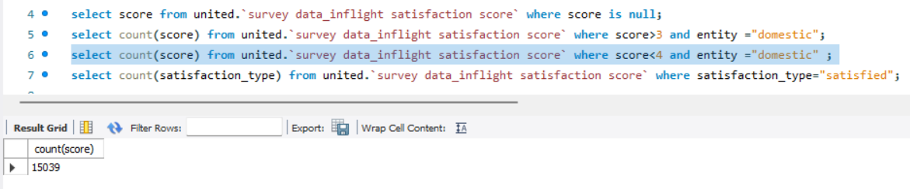
Domestic customer are most dissatisfied by the foods.
Domestic customer i.e., around 15039 customers gives less than 4 ratings.
So, our main goal to focus on domestic user satisfaction score which helps in increasing revenue of the airlines.
Around 8814 customers are satisfied with food and beverages services. In the flight.

Slide 14
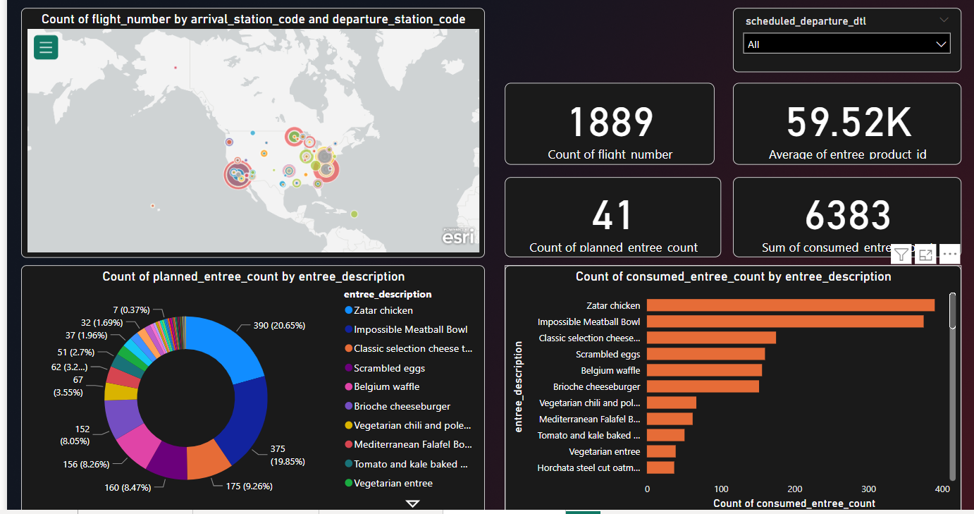
Analysis of Inventory Data
20.65% of consumer prefer zatar chicken from united airline.
Stired-fried egg noddles and ricotta and mushroom filled tortellini are less preferred.
Number of distinct flight no. are 1889.

Slide 15
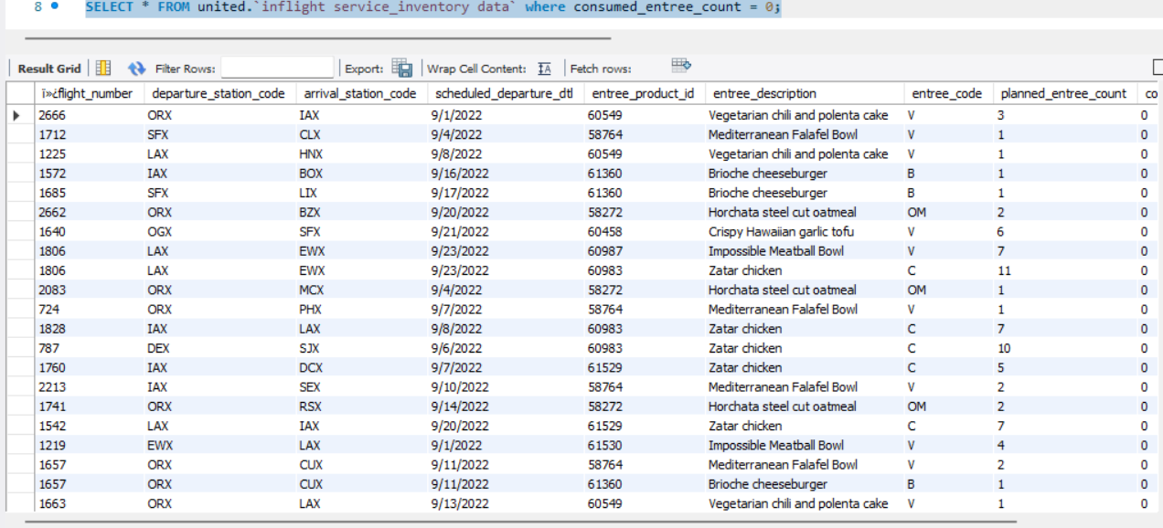
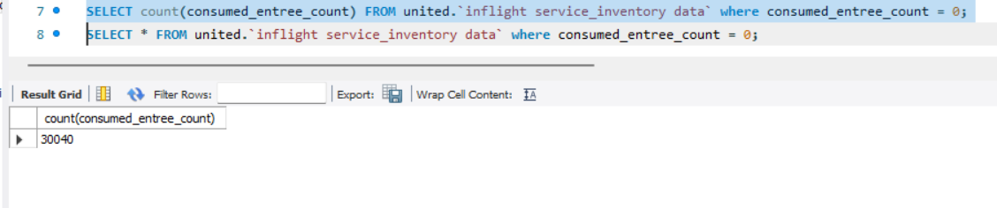
There are all of food which consumed less by users i.e. around 30040.
We could reduced the wastage of those foods which consumed less by the users.

Slide 16
Suggestion
Diverse Menu Options: Offer a diverse range of menu options that cater to various dietary preferences and restrictions. Consider including vegetarian, vegan, gluten-free, and other special meal choices to accommodate a wide range of passengers.
Quality Ingredients: Focus on using high-quality, fresh ingredients in meal preparation. Sourcing local and sustainable ingredients can enhance the perception of food quality.
Data Analysis: Continuously analyze customer feedback and satisfaction scores to identify trends and areas for improvement. Use data-driven insights to make informed decisions.
Food Sustainability: Focus on sustainable food practices by reducing food waste, utilizing eco-friendly packaging, and exploring partnerships with organizations promoting food sustainability.
Feedback Loop: Create a feedback mechanism that encourages passengers to provide real-time feedback on the in-flight dining experience. Use this data to make immediate improvements.
short haul markets (specially <500 miles) : By offering any meal-service to attract more users towards your airlines which help to increase revenue.
Customization: Allow passengers to customize their meals within certain parameters. This could include choosing their sides, dressings, or condiments.
Communication: Clearly communicate meal options and their availability to passengers during the booking process. Ensure passengers are aware of the pre-ordering option and its benefits.
In-Flight Experience: Enhance the in-flight dining experience by investing in better presentation, meal service, and cabin crew training. Ensure meals are served at the right temperature and with proper utensils.

Slide 17


Thank You
Akash Singh
Ash101999singh@gmail.com
https://github.com/Ash-pixel10/United_Airlines_PowerBi_dashboard

